Slide 1
Chapter 8 User Interface Design

Slide 2
Lesson Objectives
To describe the design principles of good user interface
To discuss the guidelines of designing color in an user interface
To assess the design of an user interface

Slide 3
Introduction
The user interface of a system is often the yardstick by which that system is judged.
An interface, which is difficult to use will, at best, result in a high level of user errors.

Slide 4
UI Design Process
Analysed &
understand user
activities
Produce paper-
based design
prototype
Evaluate design
with end-users
Produce
dynamic design
prototype
Evaluate design
with end-users
Design
prototype
Implement
final user
interface
Executable
prototype

Slide 5
Common Design Issues
System response time
User help facilities
Error information handling
Command labeling

Slide 6
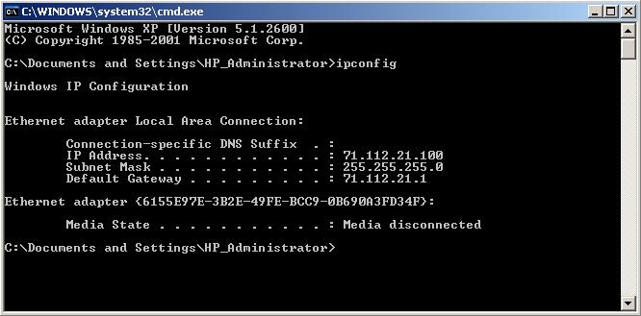
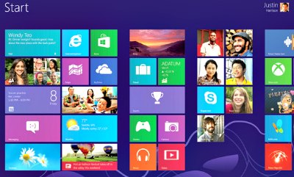
Two Modes of Designs
Basically, two modes of designs: -
text-based mode
GUI-based mode

Slide 7
Characteristics of GUI
Windows
Icons
Menus
Pointing
Graphics

Slide 8
Advantages of GUIs
they are relatively easy to learn and use
the user has multiple screens (windows) for system interaction
fast, full-screen interaction is possible with immediate access to anywhere on the screen.

Slide 9


3 Golden Rules for a Good UI Design
1. Place the user in control – People do not like to be controlled by the machine and they like to know the status of the operation/ system.

Slide 10
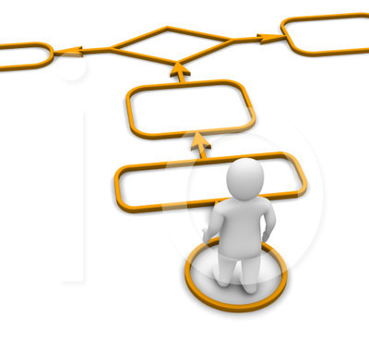
3 Golden Rules for a Good UI Design
2. Reduce the user’s memory load – people have limited short-term memory & they make mistakes when they handle too much info.

Slide 11
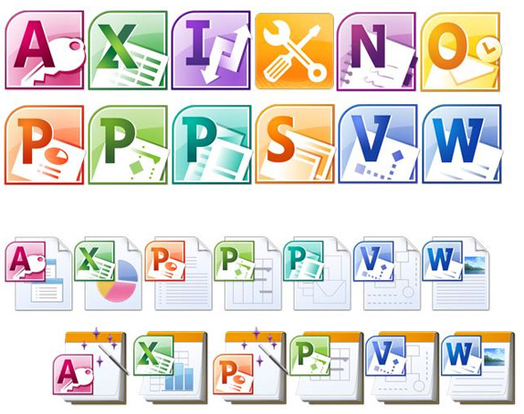
3 Golden Rules for a Good UI Design
3. Make the interface consistent – easy to learn and the knowledge learnt in one command or application is applicable in other parts of the system.

Slide 12

UI Design Principles
User interface design must take into account the needs, experience and capabilities of the system user.
User familiarity – should use the terms and concepts which are drawn from the experience of the users. E.g. Library system – operations: book in, book out, renew book etc.
Consistency – wherever possible, operations should be activated in the same way
Minimal surprise – users should never surprised by the behavior of a system

Slide 13
UI Design Principles
Recoverability – should allow users to recover from errors, e.g. Undo function
User guidance – provide help feature and meaningful feedback when errors occur
User diversity – should provide appropriate interaction facilities for different types of system user. E.g. Experience user: very detailed step-by-step way to perform a function.

Slide 14
Key Issues in Interface Design
The designer of a user interface to a computer is faced with two key issues:-
How can information from the user be provided to the computer system ?
How can information from the computer system be presented to the user?

Slide 15

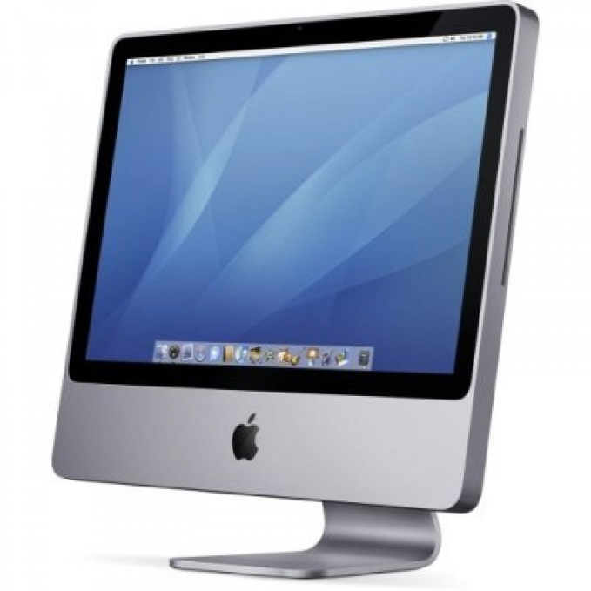

Key Issues in Interface Design
Provide info

Slide 16


Key Issues in Interface Design
1. Direct Manipulation
E.g. resize graphic

Slide 17
Key Issues in Interface Design
2. Menu Selection/Menu Systems

Slide 18
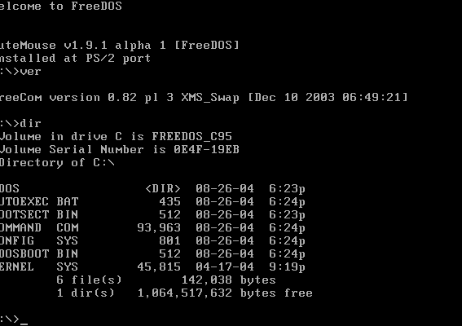
Key Issues in Interface Design
4. Command Line/Command Language

Slide 19
Key Issues in Interface Design
5. Natural Language
e.g. “delete the file named xxxx”

Slide 20

Key Issues in Interface Design
Present info

Slide 21
Key Issues in Interface Design
When presenting information to the users, the following factors must be taken into consideration:
Data Visualization
Color

Slide 22
Key Issues in Interface Design
Example : Data Visualization (Textual vs. Graphical presentation)
Jan Feb Mar Apr May June
2842 2851 3164 2500 1273 2835
4000
3000
2000
1000
Jan
Feb
Mar
Apr
May
June

Slide 23
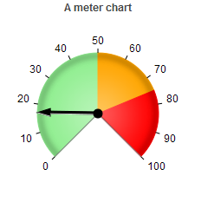

Key Issues in Interface Design
Example : Data Visualization (Present dynamically varying numeric information)
Sales

Slide 24
Key Issues in Interface Design
Example : Data Visualization (Graphical info display showing relative values)
Pressure
Temperature
0
100
200
300
400
0
25
50
75
100

Slide 25
Exercise
Q: Suggest a scenario to use Textual presentation and another scenario to use Graphical presentation.
Answer:
Textual presentation: Customer details, Order details, Account balance details, and etc.

Slide 26
Exercise
Q: Suggest a scenario to use Textual presentation and another scenario to use Graphical presentation.
Answer:
Graphical presentation:
Weather information, gathered from a number of sources, is shown as a weather map with isobars, weather fronts and so on
The state of a telephone network is displayed graphically in a network management center

Slide 27


Slide 28
The Use of Colors – Errors in Using Colors
Common errors made by designers when incorporating color in a user interface are: -
Color is used to communicate meaning
Color-blind may misinterpret the color
Human color perceptions are different
Too many colors or the colors are too bright in the display
Some colors cannot viewed comfortably for long
Cause confusion if colors are used inconsistently

Slide 29
Guidelines when Using Color
Limit the number of colors used
→ < 5 colors in a window; < 7 colors in an interface
Use color change to show a change in system status
Change of color means that a significant event has occurred.
E.g. change of color
!
!

Slide 30
Guidelines when Using Color
Use color coding to support the task which users are trying to perform
→ similar tasks – same color
→ abnormal tasks – different color
Use color coding in a thoughtful and consistent way
E.g. If using red for error message, all other parts should do the same.
Be careful about color pairings
→ Some color combinations may cause eyestrain & hard to read. E.g. Red on a blue display.

Slide 31

Guidelines when Using Color
Color pairing
Welcome to TARUC
Welcome to TARUC
Welcome to TARUC

Slide 32

Design Factors in Message Wording
Context
Experience
Skill level
Style
Culture

Slide 33
Design Factors in Message Wording
Error #27 Invalid Patient ID
Bad File Name
Illegal Operations

Slide 34
Design Factors in Message Wording
Patient J. Bates is not known to the system
Click on Patients for a list of known patients
Click on Retry to re-input a patient name
Click on Help for more information
Patients
Retry
Help

Slide 35
Support Documentation for Users
A functional description
– description of services (system evaluators)
An introductory manual
– Getting started (beginner)
A system reference manual
– facility description (experienced users)

Slide 36
Support Documentation for Users
A system installation manual
– how to install system (system administrator)
A system administrator's manual
– operation & maintenance (system administrator)

Slide 37
Exercise
Comment on the below user interface and suggest some ways to improve it (if any).

Slide 38
